Slide 1

Deep Learning Techniques for Electrical Load Forecasting
Presented By:- Tolulope Olugbenga

Slide 2
What Is Load Forecasting and Why Is It Necessary?
Load forecasting is an important part of electric utility design, planning, and operation, and it has a long history in the power industry.
A critical goal of load forecasting is to ensure that consumers receive an adequate supply of energy in order to maintain supply-demand balance.
While both statistical and machine learning (ML) techniques have been used to forecast load, machine learning algorithms are more intelligent and capable of more accurately forecasting load.
Deep learning techniques have grown in popularity in recent years due to their ability to interpret complex relationships in data more accurately.

Slide 3
What Is Load Forecasting and Why Is It Necessary?
The main goal of this research was to compare deep learning forecasting techniques to some conventional forecasting techniques currently used by various utilities to see if deep learning can better meet their needs.

Slide 4
Specified Goals for this Research Study
Identifying and implementing benchmark forecasters.
Identifying and implementing two deep learning forecasters.
Analyses were performed on three separate datasets. The forecasters' overall accuracy and daily peak prediction are compared.
Extensive examination of forecasters' ability to predict at various times of day, days of the week, months of the year, or seasons.

Slide 5
Overview of Load Forecasting
The primary goal of a power company is to ensure a constant supply of electricity in order to avoid blackouts.
Many factors influence load demand, which can be classified into four categories: economic, chronological, meteorological, and random.
Depending on the forecasting requirements, different horizons can be considered: short-term load forecasting (STLF < 2-weeks), medium-term load forecasting (MTLF < 3-years), and long-term load forecasting (LTLF > 3-years).
The focus of this research study was on short-term load forecasting (STLF).

Slide 6
Benchmark – Seasonal Naïve Forecaster (SNF)
SNF is commonly used as a starting point for developing more sophisticated forecasters, and it is mathematically represented as:
By taking seasonal trends into account, the SNF improves on the naive forecaster.
The naive formula forecasts based on the most recent observed value, whereas the SNF formula forecasts based on the previous season's value.
When SNF outperforms a more complex forecasting model, then the complex model adds no value.

Slide 7
Benchmark – Multiple Linear Regression (MLR)
MLR is a popular statistical technique for forecasting load.
The relationships between a continuous dependent variable and one or more independent variables are modeled by MLR forecasters.
Mathematically, a MLR with two independent variables is expressed as:

Slide 8
Benchmark – Auto-Regressive Integrated Moving Average (ARIMA)
ARIMA is arguably one of the most widely used statistical forecasting techniques, with widespread application in the load forecasting literature.
The ARIMA model explains data by taking time-series data from previous values and predicting linear regression outcomes.
The “AR” or autoregression component in ARIMA indicates that the model is dependent on the relationship between the current and previous data values (lagged values).
As linear regression models perform better on stationary data, the "I" or integration component is in charge of time series differencing.

Slide 9
Benchmark – Auto-Regressive Integrated Moving Average (ARIMA)
The "MA" component, or moving average, models the forecast as a function of previous forecast errors (lagged forecast errors).
Seasonality in data can be handled using the Seasonal ARIMA (SARIMA) model, which incorporates seasonal AR, MA, and differencing terms.
Exogenous variables such as temperature can be incorporated into the SARIMA, resulting in the formation of a new model known as the SARIMAX, which was used in this study.

Slide 10
Benchmark – SARIMAX Forecaster
SARIMAX (p, d, q) x (P, D, Q)S is the SARIMAX model's general form.
(p, d, q) are the non-seasonal terms AR, I, and MA, respectively. While (P, D, Q) denotes seasonal terms. And S denotes the number of time steps in the given season.
The mathematical representation of the model is shown in the equation below.

Slide 11
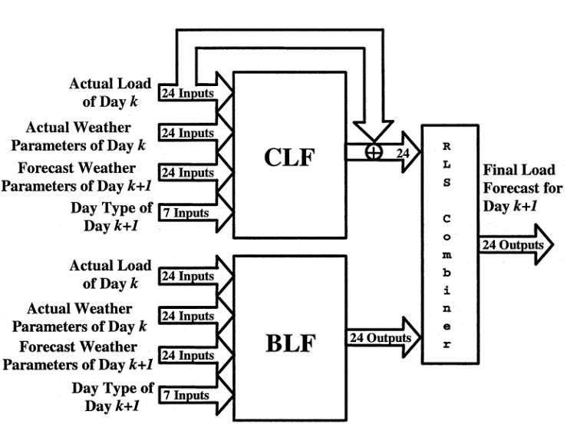
Benchmark – ANNSTLF – Generation Three
The ANNSTLF forecaster consists of three parts: a BLF forecaster, a CLF forecaster, and an RLS combiner.
Both the BLF and the CLF are shallow multi-layer feed-forward artificial neural networks (ANNs).
The RLS is an adaptive recursive least squares combiner.

Slide 12
Benchmark – ANNSTLF – Generation Three
The BLF is trained to predict regular next-day load, whereas the CLF is trained to predict changes in load demand from day to day.
Both the BLF and the CLF receive the same inputs, but their target values differ.

Slide 13
Benchmark – ANNSTLF – Generation Three
The CLF produces its final output by combining predicted changes with actual last-day values.
The BLF tends to respond slowly to sudden changes in load.
Conversely, the CLF responds to changing conditions more quickly because it uses yesterday's load as a baseline and forecasts future changes in that load.

Slide 14
Deep Learning
Deep learning is a process in which the number of hidden layers in a network is increased.
To identify the most reliable features in machine learning, a domain expert is required.
While deep learning models can be fed some input features, they can also extract high-level features from data incrementally, eliminating the need for domain expertise and time-consuming feature extraction.
The most common types of deep neural networks are convolutional neural networks (CNN), and recurrent neural networks (RNN), which include networks such as the long short-term memory network (LSTM).

Slide 15

Deep Learning – Recurrent Neural Network (RNN)
Traditional neural networks assume that all inputs and outputs are independent, but RNNs do not and rely on previous elements to influence current elements.
RNNs, in effect, augment neural networks with memory, which aids in the modeling of sequential data.
However, because the gradient descent must traverse each layer to update the state weights, RNNs suffer from vanishing gradient issues; this issue led to the development of the Long Short-Term Memory (LSTM) network.

Slide 16
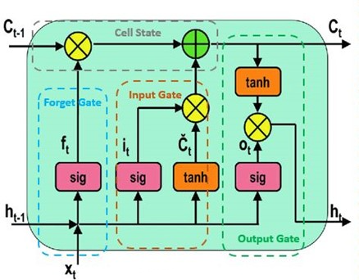
Deep Learning – Long Short-Term Memory (LSTM)
The LSTM is a type of RNN that can predict states over long time periods.
The LSTM architecture is made up of memory blocks, which are recurrently connected subnetworks (or cells).
Each memory block consists of a cell state, a forget gate, an input gate, and an output gate.

Slide 17
Deep Learning – Long Short-Term Memory (LSTM)
The cell state is essential for the LSTM function, and the three gates regulate it.
The gates allow information to pass through on an opt-in basis.
They are built with sigmoid and pointwise multiplication.
Sigmoid layers generate values ranging from 0 to 1, indicating how much of each element should be passed through.

Slide 18
Deep Learning – Long Short-Term Memory (LSTM)
The first stage is a sigmoid layer called the "Forget Gate," which determines which information from the previous cell state should be discarded.
The next step is to filter the outputs of a tanh layer used to update inputs to determine what new information will be stored in the cell state, which happens in the "Input Gate."

Slide 19
Deep Learning – Long Short-Term Memory (LSTM)
The newly acquired information is then incorporated into the cell state.
Finally, the network employs an "Output Gate" to generate outputs in the form of a filtered version of an updated cell state.
Because of the method of forgetting and remembering information within a cell, LSTM is ideal for sequential data

Slide 20
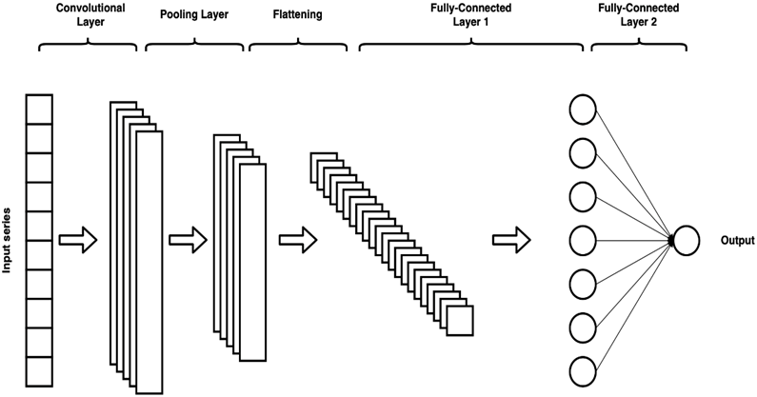
Deep Learning – Convolutional Neural Network (CNN)
CNNs are a type of deep learning network with a grid-like topology that is used for data processing.
This can include time series and image data, which can be represented as one-dimensional and two-dimensional data grids, respectively.
Because load forecasting data are time series, the focus of this work was on one-dimensional CNNs

Slide 21
Deep Learning – Convolutional Neural Network (CNN)
CNNs are well-known for their ability to extract rich feature sets from inputs, which is accomplished through the use of the convolution layer.
The convolution layer is a pattern finder that searches for patterns by applying filters to the input data repeatedly.
Each filter produces a new feature map composed of dot products whose length is proportional to the length of the filter (unless padding is utilized).

Slide 22
Deep Learning – Convolutional Neural Network (CNN)
The next layer is a pooling layer which reduces the spatial dimensions of a feature map while also decreasing localization sensitivity.
From the specified pool of neighboring elements on the same feature map, a single value is generated.
The following layer is a flattening layer, which converts the output of the pooling layer to a single one-dimensional array.

Slide 23
Deep Learning – Convolutional Neural Network (CNN)
The structure of a CNN's fully-connected layer is the same as that of a fully-connected feed-forward ANN layer.
They are trained using backpropagation to generate forecasted values.

Slide 24
The Myth of the One-Size-Fits-All Technique
Tao Hong talked about the myth of discovering the best technique. He concluded that researchers and users must understand that there is no technique that is universally superior.
The method used for load forecasting should be determined by the forecasting requirements and the dataset under consideration.
One approach is unlikely to be beneficial in all load forecasting scenarios. Different forecasters perform better or worse depending on the nature of the dataset.
Furthermore, forecast errors differ greatly across utilities, utility zones, and time periods.

Slide 25
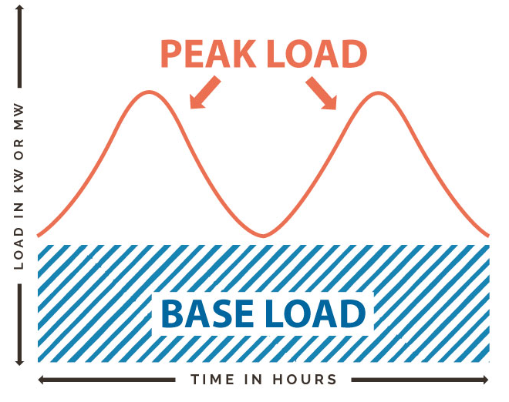
Peak Load
The term "base load" refers to the absolute minimum amount of electrical demand that must be met over the course of a 24-hour period.
Conversely, peak load refers to the maximum amount of energy drawn from the grid by a consumer over a specified period.
Peaks have three main characteristics: magnitude, temporal location, and width or duration, with the temporal location being the most important.

Slide 26
Investigation
The purpose of this work was to determine whether deep learning techniques could improve forecasting accuracy for specific utilities by comparing the accuracy of deep learning forecasters to some of the conventional forecasters used by utilities.
The focus of this work was on STLF horizons, specifically one day ahead forecasts.
SNF, MLR, SARIMAX, and ANN forecasters were compared to CNN and LSTM forecasters.
The emphasis was on predicting regular loads and daily peaks.

Slide 27
Preparation of the Datasets
This study made use of three datasets; the figure depicts the daily mean for each dataset in 2019.
One set was obtained from each of Toronto, Ottawa, and Saint John.
The datasets from Toronto and Ottawa span ten years, from 2010 to 2019.
The Saint John dataset spans 3.75 years, from 2018 to October 20, 2021.

Slide 28
Preparation of the Datasets
The load demand variables are expressed in megawatts (MW). Environment Canada provided the temperature data, which is expressed in degrees Celsius.
Outliers were identified and replaced using a Hampel filter.
Both the load and temperature values were normalized using the min-max normalization method.
The split of the training and testing datasets is shown in the table below.

Slide 29
Implementation Specifications – SNF Forecaster
The SNF forecaster set the forecast value for each hour in our test set to be equal to the previous week's lag value, where l = 168.

Slide 30
Implementation Specifications – MLR Forecaster
As shown in the table, the MLR forecaster was implemented with ten independent variables (inputs).

Slide 31
Implementation Specifications – MLR Forecaster
As shown in the equation, the model estimated a total of 56 coefficients, which included a constant, a linear term for each independent variable, and products of distinct independent variable pairs (no squared terms):
The ordinary least squares algorithm was used to fit the model to the training data.
After the model was fully specified, it was used to forecast a value for each hour in the test set.

Slide 32
Implementation Specifications – SARIMAX Forecaster
The SARIMAX model considered seasonality and used temperature as an exogenous variable.
The following are the hyper parameters used in the models:
A model was fit for each forecasted day using actual demand and actual temperature lag values from the previous 28 days, yielding a unique model for each day.

Slide 33
Implementation Specifications – SARIMAX Forecaster
To fit the model, the expectation-maximization algorithm was used, assuming a student's t distribution (which improved performance over a Gaussian distribution, based on preliminary trials).
Once the model was fully specified, it was used to forecast hourly values for the forecasted day, with the next day's 24-hour temperature acting as an exogenous variable.
This process was repeated for each day in the test set to produce a forecast for each hour.

Slide 34
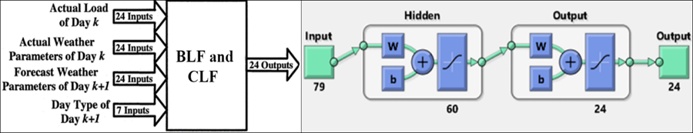
Implementation Specifications – ANNSTLF Forecaster
The diagram depicts the architecture of the BLF and CLF components:
The hidden layer was made up of 60 neurons that were both trained using resilient backpropagation.
80% of the training data was used for training and 20% for validation.
The RLS combiner was initially set up to combine the outputs of both ANNs equally (i.e., weights were set to 0.5), and the weights were updated using a least-squares algorithm based on how large the difference between predicted and actual values was.

Slide 35
Implementation Specifications – LSTM Forecaster
The ANNSTLF structure was modified by replacing the ANNs in the BLF and CLF with LSTM networks, but the architecture's inputs and structure remained the same.
Both the BLF and CLF LSTM blocks had four layers: a sequence input layer with 79 inputs, an LSTM layer with 100 hidden units, a fully connected layer with 24 outputs, and a regression layer.
The entire training set was used to train both LSTM networks using the Adam optimization algorithm and the training options listed on the table (all unspecified options were set to default values in MATLAB R2021b).

Slide 36
Implementation Specifications – LSTM Forecaster
Once trained, the LSTM networks produced 24 outputs representing 1-day ahead hourly forecasts, just like the standard ANNSTLF.
The final results of the two LSTM networks were then combined using the RLS combiner.
This process was repeated for each day in the test set to generate a forecast for each hour.

Slide 37
Implementation Specifications – CNN Forecaster
CNN networks were implemented for use in the ANNSTLF architecture in a manner similar to that of LSTM networks.
Both CNNs had the following layers: an input layer with 79 inputs; a convolutional layer with 15, 6x1 filters; a rectified linear unit activation layer (ReLU); a max-pooling layer with a 2x1 pool size; a fully connected layer with 24 outputs; and a regression output layer.
The entire training set was used to train both CNN networks using the Adam optimization algorithm and the training options listed on the table (all unspecified options were set to default values in MATLAB R2021b).

Slide 38
Implementation Specifications – CNN Forecaster
Once trained, the CNN networks produced 24 outputs representing 1-day ahead hourly forecasts, just like the standard ANNSTLF.
The final results of the two CNN networks were then combined using the RLS combiner.
This process was repeated for each day in the test set to generate a forecast for each hour.

Slide 39
Performance Metrics
MAE – Mean Absolute Error.
MAPE – Mean Absolute Percentage Error.
MBE – Mean Biased Error.
RMSE – Root Mean Squared Error.

Slide 40
Performance Analysis
The goal of this study was to forecast 1-day ahead loads and identify daily peaks.
MAPE and RMSE were used to evaluate forecaster performance in regular load forecasts.
MAPE, MAE, and MBE were used to evaluate forecaster performance in predicting and identifying daily peaks.
MAPE was used to quantify the accuracy of the forecasted peak magnitudes by calculating the difference between the forecast and actual peak values.
MBE and MAE were used to calculate the time difference between occurrence of actual and forecasted peaks. The outcomes of these two metrics are expressed in minutes.

Slide 41
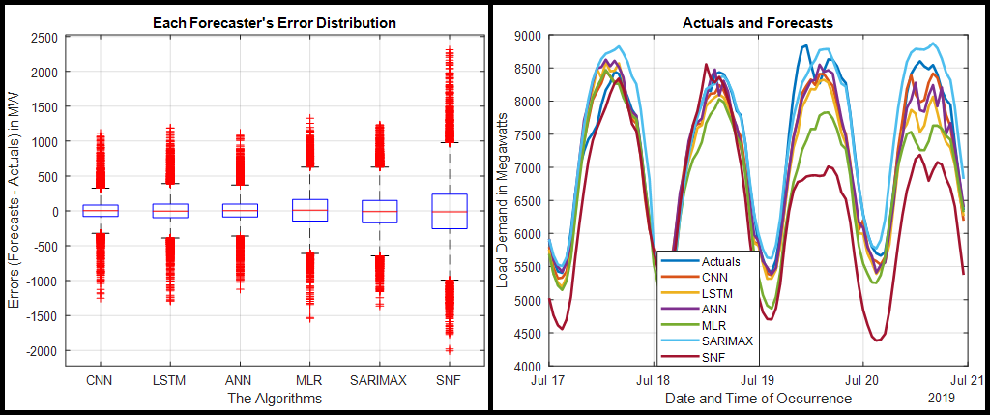
Overall Performance - Toronto Dataset

Slide 42
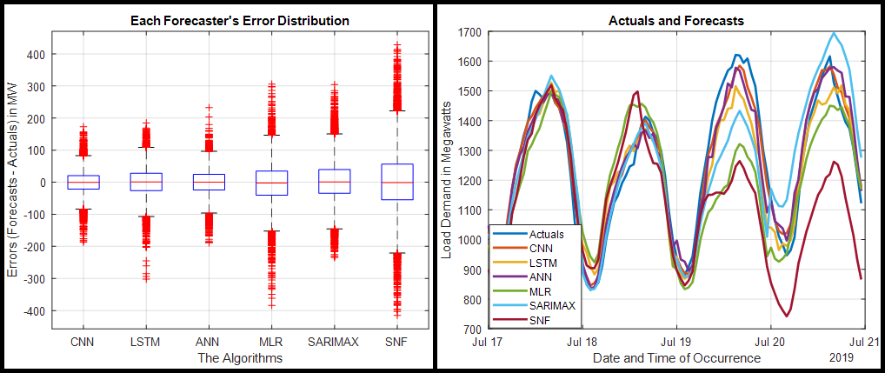
Overall Performance - Ottawa Dataset

Slide 43
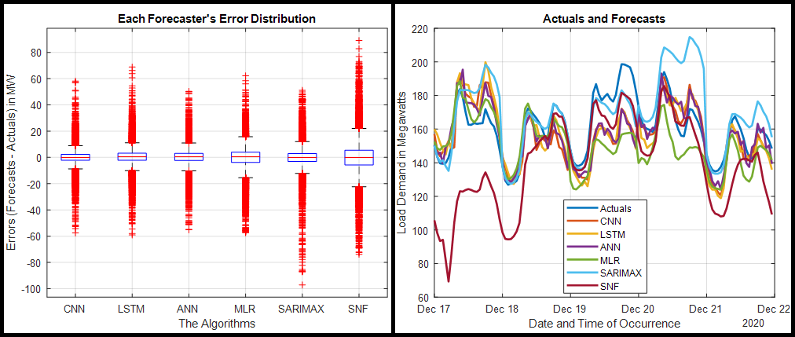
Overall Performance – Saint John Dataset

Slide 44
Conclusion Based on Overall Performance
Based on the overall accuracy, we can conclude that the CNN performed the best overall, followed by the ANN and the LSTM.
The CNN appears to have the tightest distribution of errors across all test datasets in the error distribution plots.
In terms of predicting the magnitude of daily peaks, the CNN had the lowest MAPE values across all test datasets; the CNN was followed by the ANN and the LSTM.
The MAE values show that the CNN forecaster predicted the time of occurrence of the daily peaks the best; the LSTM and ANN forecasters trail the CNN in the Toronto and Saint John datasets; however, the SARIMAX forecaster outperforms the LSTM and ANN in the Ottawa dataset.

Slide 45
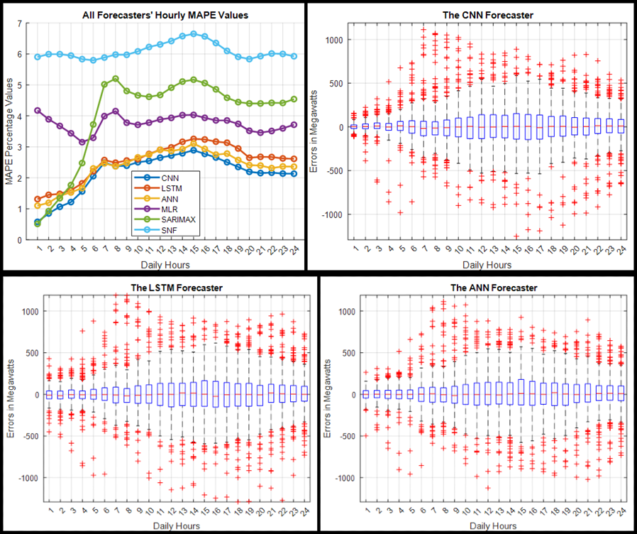
Comprehensive Evaluation – Toronto Dataset - Hourly
For each hour of the day, the CNN had the tightest error distribution and the lowest MAPE values.
It was followed by the ANN and the LSTM forecasters.
Around 15:00, all three forecasters CNN, ANN, and LSTM made their worst predictions; quieter times, such as around 1:00, were predicted much more accurately than busier times.

Slide 46
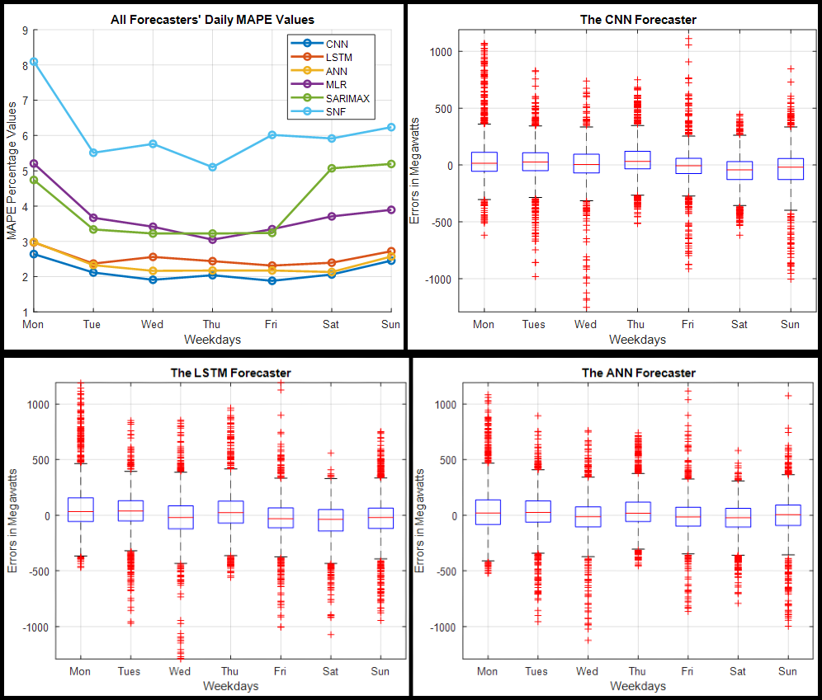
Comprehensive Evaluation – Toronto Dataset - Daily
As we can see, Monday was the worst day for almost all forecasters to predict, with Sunday coming in second place.
Tuesdays through Fridays were the most predictable days for the forecasters.
CNN's MAPE values were the lowest on all seven days of the week, and all of its boxplots were the narrowest.
The ANN is ranked second, with the LSTM edging it out in Monday's predictions.

Slide 47
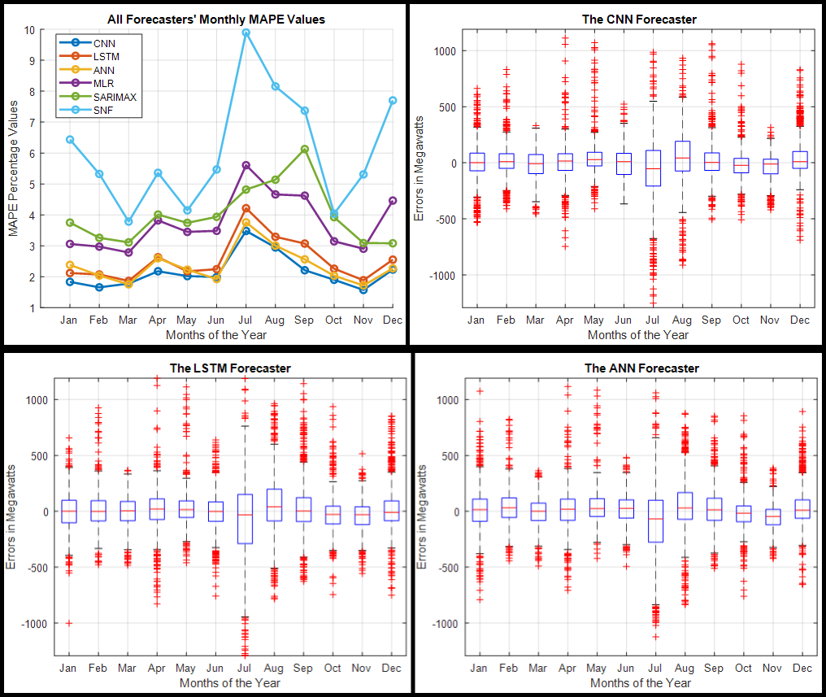
Comprehensive Evaluation – Toronto Dataset - Monthly
Except for SARIMAX, which had the worst predictions in September, all forecasters had their worst predictions in July, but the other forecasters also found September difficult to predict.
August was the month in which all forecasters made their second-worst predictions.
Forecasters found February, March, and November to be relatively simple to predict.

Slide 48
Comprehensive Evaluation – Toronto Dataset - Monthly
Over ten months, the CNN had the lowest MAPE values and was only outperformed by the ANN in March and June.
The ANN is ranked second because it was only surpassed by the LSTM in January, while the LSTM is ranked third.
The SNF had the worst overall performance across all months.

Slide 49
Comprehensive Evaluation – Toronto Dataset - Seasonal
Summer was the season that forecasters had the most trouble predicting.
CNN had the lowest MAPE and RMSE values across all four seasons.
The ANN is ranked second, having only been surpassed in the winter by the LSTM, which is ranked third.
Autumn was the season with the lowest metric values for the CNN and ANN, while spring was the season with the lowest metric values for the LSTM.

Slide 50
Comprehensive Evaluation – Toronto Dataset - Discussion
In the Toronto dataset, the summer months of June through August saw the highest demand for electricity; these were also the months during which forecasters had the most difficulty forecasting.
This can be attributed to two factors: first, the increased demand can be attributed to the fact that the summer air in Toronto is typically hot throughout the day, including evenings, necessitating the use of air conditioning by almost everyone.
Furthermore, Toronto is a popular tourist destination, and everyone wants to visit during the summer when the weather is nicer.
Because demand is most stable in the spring and autumn, forecasters found these seasons to be easier to forecast.

Slide 51
Comprehensive Evaluation – Toronto Dataset - Discussion
Most forecasters found it easier to forecast quieter times, such as around midnight in the early mornings, than busy times, such as late mornings and afternoons, when everyone is awake and demand for electricity is high.
We saw a lot of fluctuation in demand on Mondays, and because almost all of our forecasters used the previous day's demand as a predictor, Mondays and Sundays were the most difficult to predict for most forecasters.
Forecasters were more accurate from Tuesday to Friday, during the middle of the week; because these days were more stable and have a high degree of similarity.
The CNN forecaster performed the best across all time periods and seasons, with the ANN and LSTM finishing second and third, respectively.

Slide 52
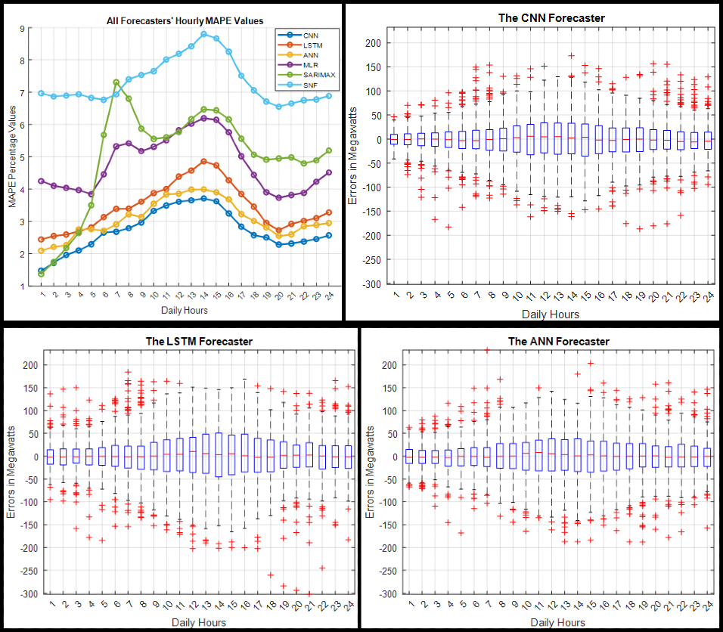
Comprehensive Evaluation – Ottawa Dataset - Hourly
While the CNN had the tightest error distribution and lowest MAPE values for nearly every hour of the day, the SARIMAX outperformed it at 01:00.
The ANN comes in second, with the LSTM outperforming it only during the 4:00 hour; the SARIMAX also outperforms the ANN between 01:00 and 04:00 hours.
The LSTM comes in third place.

Slide 53
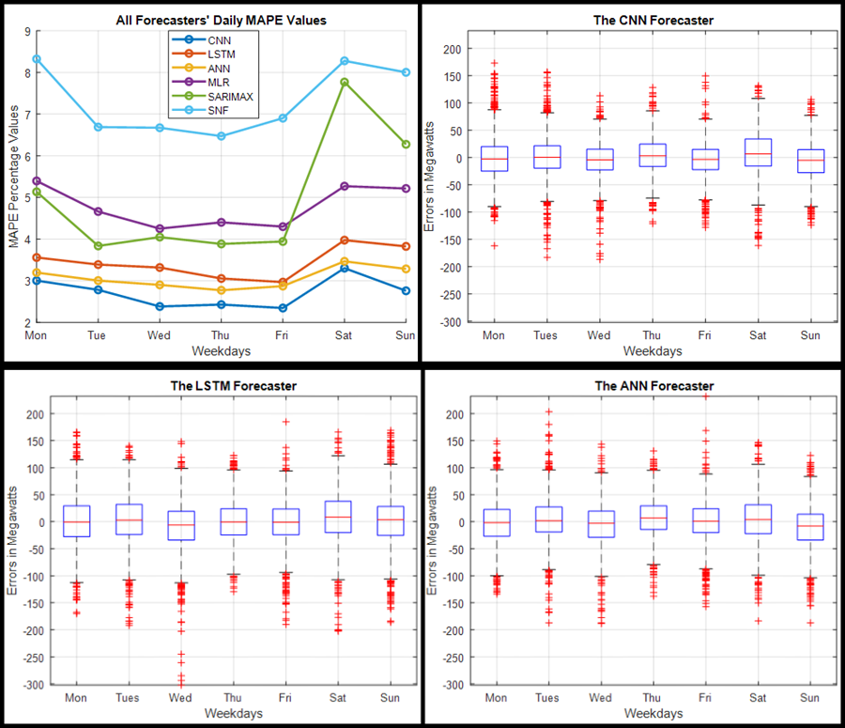
Comprehensive Evaluation – Ottawa Dataset - Daily
We can see that Saturdays and Mondays are the most difficult days to forecast for almost all forecasters.
The most predictable days were Tuesdays through Fridays.
Among all forecasters, the CNN had the lowest MAPE values and the narrowest boxplots.
The ANN comes in second, and the LSTM comes in third. The SNF performed the worst overall.

Slide 54
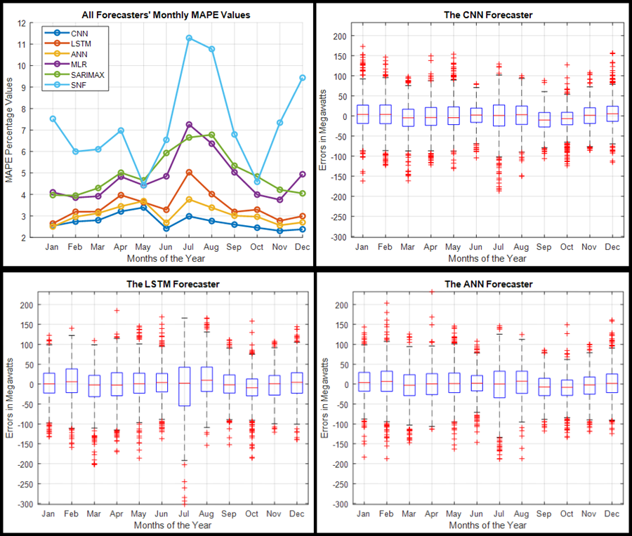
Comprehensive Evaluation – Ottawa Dataset - Monthly
It is clear that, except for CNN, July was the most difficult month to forecast.
CNN determined that July is a relatively easier month to predict, with the worst predictions coming in April and May.
Across almost all months, the CNN had the lowest MAPE values and the narrowest error distribution; it is only surpassed in January by the ANN.
The ANN is ranked second, having been surpassed by the LSTM in May. The LSTM is ranked third.

Slide 55
Comprehensive Evaluation – Ottawa Dataset - Seasonal
CNN and ANN made their most dire predictions in the spring.
All other forecasters, including the LSTM, had their worst predictions in the summer.
The LSTM and ANN had the easiest time forecasting the winter months.
CNN and MLR made their best predictions in the autumn.
To facilitate interpretation, all previous observations were made with MAPE values rather than RMSE values.
However, CNN had the lowest MAPE and RMSE values across all four seasons.
The ANN comes in second, with the LSTM coming in third.

Slide 56
Comprehensive Evaluation – Ottawa Dataset - Discussion
The Ottawa dataset is like the Toronto dataset, but there are a few key differences. The months with the highest average demand were January, February, July, and December.
Except for CNN, July proved to be the most difficult month to forecast. CNN ranked July as the third most difficult month, trailing only April and May.
Spring was the most difficult season to forecast for the ANN and CNN, with summer coming in second.
Most forecasters, including the LSTM, found summer to be the most difficult season to forecast. Winter was the most predictable season for the LSTM and the ANN.

Slide 57
Comprehensive Evaluation – Ottawa Dataset - Discussion
Most forecasters made their worst predictions between 11:00 and 16:00, when most people are awake and using electricity or working.
Mondays and Saturdays were the most difficult days to forecast.
This is like what we saw in the Toronto section because almost all our forecasters used the previous day's demand as a predictor, and Monday demand differs from Sunday demand, as does Saturday demand from Friday demand.
Forecasters also had a difficult time predicting Sundays, but Mondays and Saturdays were the most difficult.
The CNN forecaster performed the best across all time periods and seasons, with the ANN and LSTM forecasters coming in second and third place, respectively.

Slide 58
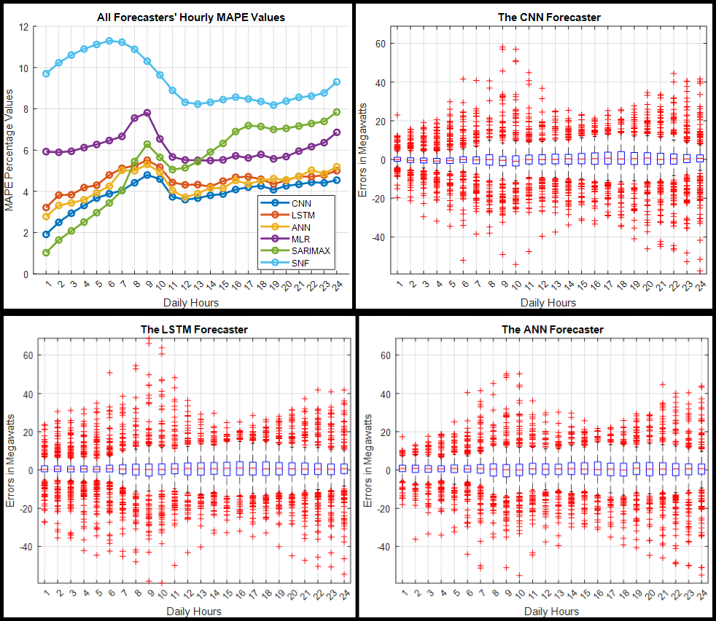
Comprehensive Evaluation – Saint John Dataset - Hourly
The average peak demand occurs between 10:00 and 13:00, with a second peak around 19:00.
Except for the SNF and SARIMAX, all forecasters had their worst predictions around 9:00.
The SARIMAX forecaster made the most accurate predictions between 1:00 and 6:00.
CNN performed best between 7:00 and 24:00, as well as during the day's peak hours.

Slide 59
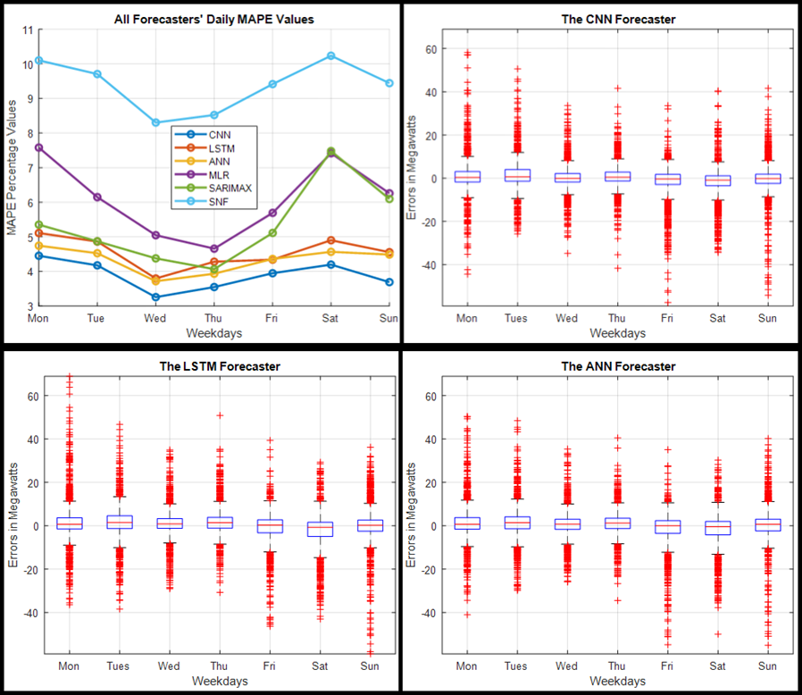
Comprehensive Evaluation – Saint John Dataset - Daily
We can see that the forecasters had the most difficulty predicting Mondays and Saturdays.
The most predictable days were Wednesdays and Thursdays.
The CNN provided the best predictions on all seven days of the week.
The ANN is second, with the LSTM outperforming it only on Fridays, and the LSTM is third, with the SARIMAX outperforming it only on Thursdays.

Slide 60
Comprehensive Evaluation – Saint John Dataset - Monthly
The city of Saint John experiences its highest demand during the winter months
Most forecasters made their worst predictions in December.
The SARIMAX forecaster produced the most accurate forecasts in January, November, and December
CNN's predictions for the rest of the year were the most accurate.

Slide 61
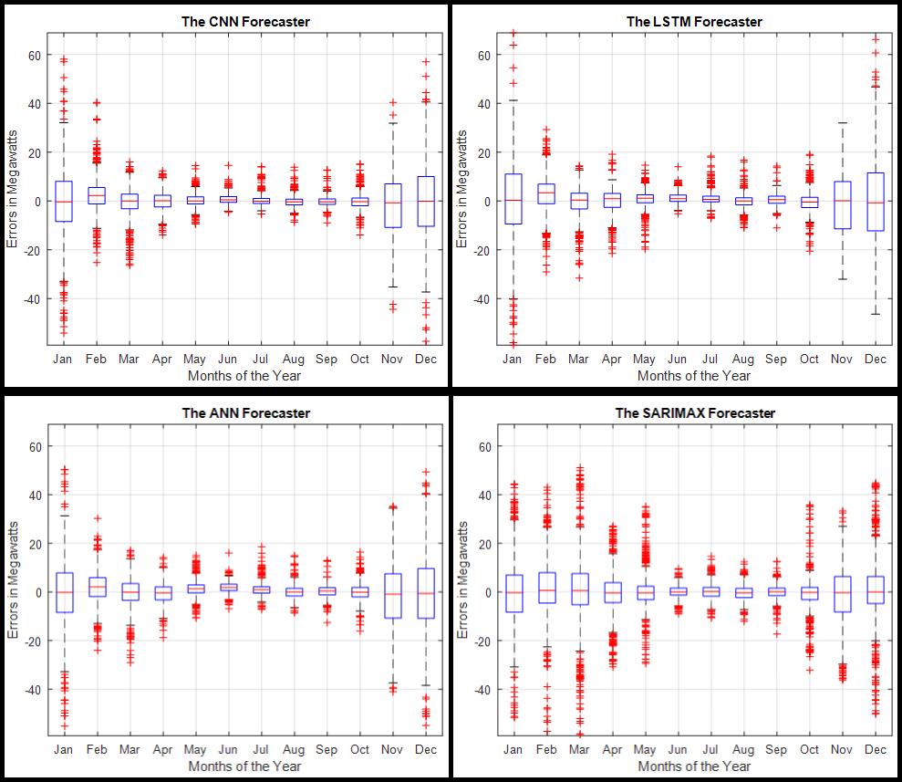
Comprehensive Evaluation – Saint John Dataset - Monthly
Because the ANN and LSTM are inextricably linked, determining which produces more accurate predictions is difficult.
The most error-prone months for the SNF were January to May and October to December.

Slide 62
Comprehensive Evaluation – Saint John Dataset - Monthly
Each forecaster has a similar performance to the others, with one outperforming the others one month and the others the next.
SARIMAX performed better during the winter months but less well during the rest of the year.
Although, CNN had the most accurate predictions for the remaining nine months of the year, it cannot be declared the winner because SARIMAX's best months coincided with the months with the highest demand.

Slide 63
Comprehensive Evaluation – Saint John Dataset - Seasonal
Except for SNF, all forecasters had their worst predictions in the winter.
SNF had its worst predictions in the spring.
Summer was the most predictable season for forecasters because demand was more stable.
CNN performed the best overall across all four seasons, while SNF performed the worst.

Slide 64
Comprehensive Evaluation – Saint John Dataset - Discussion
The Saint John dataset differs significantly from the datasets in Toronto and Ottawa.
The Saint John dataset has the highest load demand during the winter months when temperatures are at their lowest, while demand is relatively lower during the remaining months of the year.
As a result, most forecasters found the winter months to be the most difficult to predict, while the summer months were the easiest.
The SARIMAX forecaster was the most accurate in some of the winter months, but it was not very accurate in the remaining months of the year, whereas the CNN forecaster was the most accurate.

Slide 65
Comprehensive Evaluation – Saint John Dataset - Discussion
One possible explanation for the SARIMAX forecaster's performance is that the Saint John test dataset is highly affected by weather conditions, particularly during the winter.
And the only exogenous variable that the SARIMAX forecaster uses are temperature lag values from the previous 28 days as well as the 24-hour temperatures values for the day we are predicting.
Mondays and Saturdays were the most difficult days to forecast for the same reasons as the Ottawa and Toronto datasets.
The CNN performed the best overall across all days of the week, followed by the ANN and LSTM.

Slide 66
Comprehensive Evaluation – Saint John Dataset - Discussion
The peak period for demand in Saint John is between 10:00 and 13:00. Most forecasters struggled to forecast around 9:00.
The SARIMAX forecaster was the most accurate between 1:00 and 6:00, but CNN was the most accurate throughout the rest of the day, including the peak hours.

Slide 67
Summary
This research study's purpose and objectives have been fully met.
Using three different datasets, we compared four benchmark forecasters to two deep learning techniques, CNN and LSTM, with the goal of determining overall performance in forecasting regular load and daily peaks.
In terms of overall accuracy, CNN, LSTM, and ANN were the most accurate forecasters.
The performance of all forecasters was then examined on an hourly, daily, monthly, and seasonal basis across all test datasets.

Slide 68
Summary
CNN, ANN, and LSTM were the top forecasters across all time periods and seasons in the Toronto and Ottawa datasets.
However, in the Saint John dataset, the SARIMAX forecaster outperformed them in January, November, and December, but the SARIMAX forecaster was not as accurate for the rest of the year.
The SNF had the worst overall performance across all periods and seasons, which is to be expected given that load demand is generally not stable week to week.
Mondays, Saturdays, and Sundays were difficult to predict for all forecasters, but the middle of the week was easier to predict because demand was more stable.

Slide 69
Summary
The months with the highest demand, such as July in the Toronto and Ottawa datasets and December in the Saint John dataset, were the most difficult for forecasters to predict, while most months with lower or relatively stable demand were easier.
Overall, CNN and LSTM ranked first and third among all forecasters in predicting the test datasets over all time periods.
The ANN is ranked second, but most LSTM and ANN predictions were quite similar, and the LSTM outperformed the ANN in several cases.
Based on our overall analysis and comparison across datasets, we can conclude that deep learning techniques such as CNN and LSTM have a lot of potential in the field of load forecasting.

Slide 70
Contributions
Deep learning techniques were considered due to their exceptional performance when applied to a wide range of problems.
We assessed the CNN and LSTM for their added value by comparing their performance to that of some conventional forecasters.
This research contributes to the maturation of the ongoing debate about the use of deep learning techniques in load forecasting.
We implemented forecasters that have been shown in the recent literature to be more adaptable to external factors such as annual increases in electricity demand or temperature shifts.

Slide 71
Contributions
We also implemented forecasters that can recognize complex data relationships without explicit user specifications.
We evaluated the performance of all forecasters on three datasets
Because two of them are publicly available, this work is reproducible and will serve as a valuable benchmark for future research both within and outside of our smart-grid team

Slide 72
Future Work
Incorporating more exogenous variables such as those used by the MLR for the ANN, CNN, LSTM, and SARIMAX models can improve their load forecasting accuracy.
Incorporating more lag values, such as those from the previous week, rather than just those from the previous day, can improve the performance of most forecasters in predicting Mondays, Saturdays, and Sundays.
Furthermore, depending on the analyst's objectives, weather variables such as humidity, dewpoint, and wind direction/speed can be used in addition to temperature.
Rather than using the ANNSTLF architecture, another approach for the CNN and LSTM that may improve their load forecasting performance is to implement them as temporal versions.

Slide 73
Future Work
Additionally, hybrid models incorporating CNNs, and LSTMs may be an option, as some researchers have discovered that combining these two models improves performance.
When it comes to daily peaks, utilities benefit from knowing when they will occur and how long they will last. As a result, another approach for future work is determining the width of demand peaks.
Furthermore, some researchers have observed improved performance when separate models are implemented to forecast specific days, such as weekdays and weekends, or specific months, such as winter and summer.

Slide 74
Thank you for your attention ☺
Merci pour votre attention ☺

